Slide 1
BEYOND ACCIDENTAL ARCHITECTURE
@plainprogrammer #OReillySACon
Notes:
Thanks for coming out this morning for my session, Beyond Accidental Architecture.

Slide 2
James Thompson
@plainprogrammer
Director of Software Development
Cingo Solutions
Notes:
My name is James Thompson. I am the Director of Software Development for Cingo Solutions. And, you can find me online almost everywhere as plainprogrammer.

Slide 3
Questions
Notes:
As we are going through this session, I will stop at a couple points to take questions. So, you won’t need to save them up until the end. Your cue will be a slide just like this one.

Slide 4
Notes:
Every software system has an architecture. That architecture may not always be particularly pleasant or welcoming, but there is an architecture.
Often our frame of mind leads us to think about framework choices and design patterns as software architecture. And, those are some of the expressions of a software’s architecture, but they are not necessarily the architecture itself. And, that’s because the architecture of a software system, like the architecture of a building, or of a major utility, principally revolves around intent and use.

Slide 5

Notes:
Planning around intended use, capacity, and capability are key aspects of the architecting of any complex system. That is why most systems or structures, whether software or otherwise, don’t start out being hard to maintain or use. They become that way over time. This happens for lots of reasons: unexpected growth, changes in preferences and sometimes simple neglect. What starts out as intentionally designed becomes an accident of circumstances. And, unless those circumstances are adapted to the system will degrade naturally over time.

Slide 6
Accidental
Architecture
Notes:
That is what I mean by accidental architecture. When circumstances overtake intentionality with respect to the needs of a software system. But, how do we recover from that? Well, to answer that I want to appeal to one of my favorite definitions for software architecture. It comes from Martin Fowler’s article in the July–August 2003 issue of IEEE Software titled “Who Needs an Architect?”

Slide 7
Architecture is about the important stuff. Whatever that is.
— Martin Fowler
Notes:
“Architecture is about the important stuff. Whatever that is.” I find Fowler’s definition to be vague, but strangely useful. It doesn’t assume any specific level of detail about what constitutes “important stuff.” Instead, he just leaves it open.
Sometimes the database, or even the backing storage engine of a database could be an architectural concern. Sometimes, a particular language, or framework, or pattern might be important to the architecture. What is nice about Fowler’s definition is that it is incredibly flexible.
So, it’s able to encompass the structures, decisions, processes, and other functional and non-functional details that could be architectural for a given software system.

Slide 8
Accidental
Architecture
Notes:
So, an accidental architecture emerges when we lose sight of the “important stuff.”
Accidental Architecture emerges whenever we lose touch with stakeholders. It creeps in when technology interests overtake business ones. Whenever the environment around a system is more impactful than any real consideration of the intent, and usefulness of the system we are likely to see the architecture of that system stray.

Slide 9
Notes:
Rarely is this kind of inattention malicious. So, I want to clearly state that Accidental Architecture is not bad in some moral sense, it’s just not helpful. And, that is what I think we really ought to strive for: software architecture that helps us improve the system when and where necessary. When the patterns, choices, and technologies of a system work against us, we have encountered Accidental Architecture.
So, how do we move in that direction, if we recognize that our system’s architecture has strayed?

Slide 10
Notes:
We have to find a path back to deliberate architectural choices and keeping our teams collaborating. It starts with helping our teams understand what decisions are architectural.
I’ve been on a few teams where architecture is all about tech choices: frameworks, folder structures, build tools, and the like. This kind of technology-focused thinking about architecture often comes up when teams are chasing fashionable tech. And, this kind of thinking happens up and down the tech stack.
[Riff on Hobbyist mentality]

Slide 11
Notes:
Kubernetes is hot right now, and it solves some real problems. But not every team needs to solve those problems. The same goes for everything from the monolith versus microservices debate, to Vue.js versus React versus jQuery versus whatever new framework just got pushed to NPM while I’ve been talking.
[Riff on Technology & Pattern fixation: microservices]
The problem often comes back to the fact that we aren’t thinking architecturally, we’re thinking technologically.

Slide 12
Questions
Notes:
Has anyone else observed a problem when teams become too fixated on the technologies rather than the aspects of a system that really matter?

Slide 13
Thinking
Architecturally
Notes:
Now, there are some great resources out there for understanding architectural decisions and not getting hung up on technology.

Slide 14
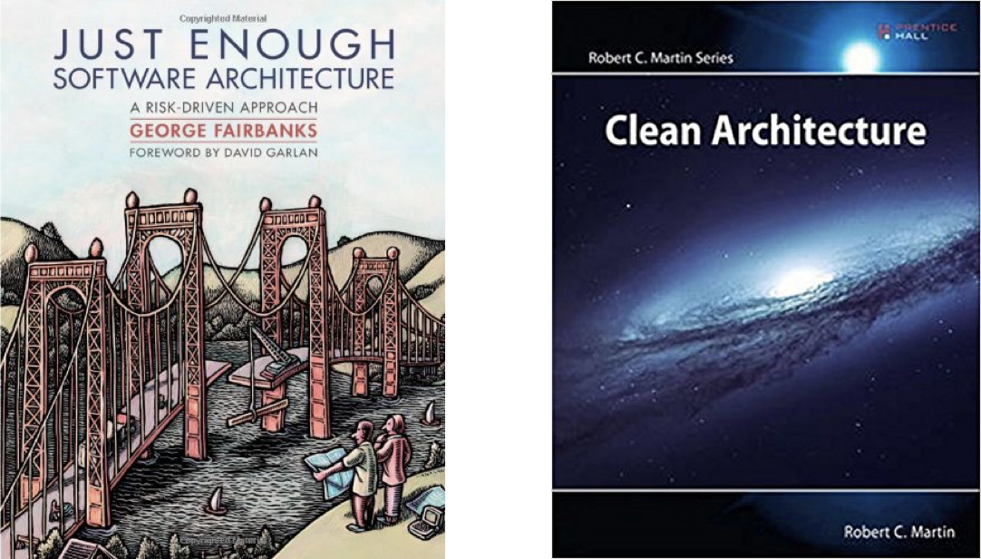
Notes:
I’m a big fan of these three books in particular. And, all three present software architecture from subtly different perspectives. But none of them are technology centric. Eric Evans and the stable of books that surround it is heavily focused on reflecting the needs and knowledge of the domain experts. Fairbanks argues for investing in architecture in proportion to the risks surrounding different areas of a project. And, Martin explicitly advocates building systems in a way that pushes specific tools and frameworks to the periphery in order to focus, like Evans, on what the system is really meant to do.
All three of these books, and others, can help your teams understand that software architecture is about more than just the technology and tool choices we make. And, that’s probably the first big step that most teams need to take: they need to understand that software architecture is bigger than they think and less tied to technology than they may be comfortable with.
[Riff on: So, start a book club]
[Riff on: be inclusive in who you invite to discuss architecture]

Slide 15
This One Time…
Notes:
So, let’s take a quick detour into an example from my past around architectural decision-making.
Several years ago, I worked for a food storage company. They manufactured and sold their own meal kits. They were not a technology company, and when I started working for them, they were running an online store using Magento and they were spending around a thousand dollars a month for a single dedicated server to run their entire e-commerce system.

Slide 16
This One Time…
Notes:
The online store wasn’t just their products though. A segment of their customers were camping and outdoor enthusiasts. So, they had partnered with another company who drop-shipped a diverse catalog of camping and outdoor recreation products.
This meant their system needed to keep in sync with this other company’s catalog and inventory. After spending a couple months maintaining the existing system it became apparent that sticking with Magento was going to require substantial increases in the complexity of the hosting environment to keep up with growth.
So, out of necessity we reassessed whether Magento was the right solution and this led to the identification of the actual important features of this company’s e-commerce system.

Slide 17
This One Time…
Notes:
First, they needed it to be reliable. The company was diversifying both its sales channels and its product offerings. Downtime had a big impact on the bottom line. And, since I was the only person maintaining the site, I was the only one who could fix it when it had issues. This meant that running the site ourselves represented a huge business risk since maintaining the site was not my only responsibility.

Slide 18
This One Time…
Notes:
Second, there was nothing special about our store. We sold stuff online. Some of it was ours, and a bunch of it was fulfilled by someone else. But the actual mechanics of selling stuff online was all stock.

Slide 19
This One Time…
Notes:
Third, the integration and optimization of other systems around the e-commerce site was the source of most of our technological complexity. We had a subscription service for a subset of our products. We had experienced some pain with our once a day inventory sync with our drop-shipping partner. And, getting orders to the warehouse for fulfillment was not as smooth as we wanted.

Slide 20
This One Time…
Notes:
So, we decided to ditch Magento. Maintaining a specific software system was not valuable and the expected increases in server costs and complexity with a maintenance staff of just me was problematic. So, we switched to Shopify. They provided a cost-effective option that allowed us to not worry about reliability and instead focus on the integrations with our partner, optimizing our fulfillment process, and improving the backend for supporting our subscription service.
The e-commerce system as a technology was not important to the business. We just needed a reliable way to sell stuff online and integrate that into the rest of the business.

Slide 21
It’s about finding what matters
Notes:
Now, that’s a really simple example of how focusing on what is truly important to the stakeholders of a system can lead to better decision-making. I still made missteps in other areas that I would do very differently today. But, the adoption of Shopify and shifting to focus on developing the custom integrations that provided real value is still something I’m proud of.
But, how do we have the conversations that lead to the kind of clarity that allows us to make decisions focused on what has real value, what Martin called the “important stuff?”

Slide 22
Talk with the people who know
Notes:
First, gather your stakeholders. Before you can identify or talk about what’s important you have to get the people who know the answers together. Gather insights from your users, your customers, whoever it is that will use or is using your software system and find out what matters to them.
Now, be careful. You will likely have to ask why to a lot of the information you get. Because often users of software systems are narrowly focused on what it enables them to do, and sometimes that can be just an electronic replacement for a problem that would otherwise be addressed by paperwork and process. You will need to dig in to get at why the software is valuable and what is most valuable about it.
This is about understanding the problem domain of your system. Until you understand what problems you’re trying to solve and why, it is very difficult to identify what the important parts of a solution are likely to be. And, the answers will vary wildly from one system to another.

Slide 23
Distinguish between functional and qualitative factors
Notes:
Next, distinguish between functional and qualitivative factors. A lot of what you are likely going to hear about will relate to what the system does. But you need to be on the lookout for those characteristics that relate to non-functional expectation. Do they expect certain parts to be customizable in some peculiar ways? Is some of the system subject to highly variable utilization, such as everyone trying to submit expenses on the last day of the month? Or are there other details that are going to impact how the system needs to be constructed that are not directly related to what the system does

Slide 24
Take your team
Notes:
Third, don’t do it alone. I worked as the solo developer a lot in the first several years of my career and those were the years when I made the poorest decisions. Sometimes out of simple ignorance, but more often because there were no other ideas than mine to consider. But, also don’t isolate decisions with a small group of people. I firmly believe that every developer can contribute to architectural discussions.
Sometimes that more junior team member asks a question that had completely escaped the notice of everyone else. Sometimes that team member who has worked for years in the code is able to point out where critical code path is going to be a bottleneck to a process no matter how big your Kubernetes cluster can automatically scale. And, sometimes even a product manager can point out where all the engineers are making a simple problem’s solution more complex than it ought to be.
Even the architects of skyscrapers and massive utilities are not so wise as to be able to ignore the input and even correction of civil engineers and construction crews when their grand visions actually have to be built. And, so we should not be so arrogant in the realm of software architecture to think that collaborative effort won’t yield benefits for our work as well.

Slide 25
Questions
Notes:
Are there other things to consider when trying to regain deliberate architectural thinking?
How do we make sure that we are addressing the important things?

Slide 26

Notes:
So, you’ve helped guide your team towards how to think architecturally and you’ve started having the conversations necessary to surface the important details of your system. The next stage is how to you preserve that knowledge for the team?
How do you document architectural decisions and details?
I have mixed feeling about documentation.

Slide 27
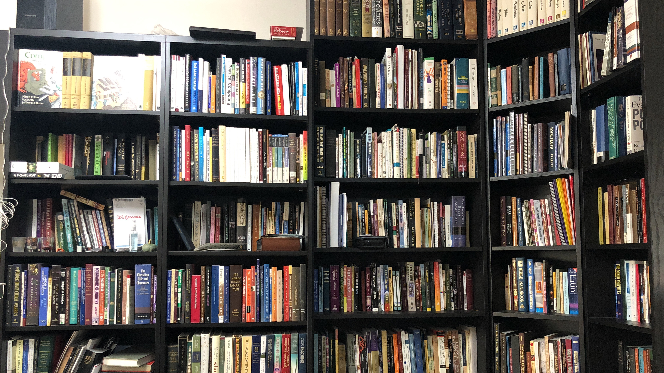
Notes:
That is part of my personal library. On the one hand I really like books and that tends to incline me towards liking to have copious documentation. But when it comes to our software projects I have experienced that most documentation becomes inaccurate very shortly after it is written. So, I have had to intentionally suppress my basic desire to want lots of documentation in favor of asking myself what the right amount of documentation is.

Slide 28
It’s not about volume
Notes:
But then it’s not just about the volume of documentation, a big factor for many teams is the location of that documentation. Annie Sexton delivered a talk at RubyConf this past November on the dangers of tribal knowledge that is worth watching. In that talk she describes the process of documenting specifically around support needs for Heroku. But, some of the advice she gives is valuable for all forms of documentation.

Slide 29
Get it in one place
Notes:
First, get it in one place. …

Slide 30
Make it discoverable
Notes:
Second, make it discoverable. …

Slide 31
Make it easy to update
Notes:
Third, make it easy to update. …

Slide 32
Give it an expiration date
Notes:
Fourth, give it an expiration date. …
Annie had more insights that may be applicable in various cases, but those four insights are almost universally applicable.

Slide 33
It’s about usefuleness
Notes:
In software projects I like keeping documentation close to the code it describes. I like tests as specifications, which is why I use BDD-style frameworks. I dislike inline code comments unless they are explaining why something is done a specific way. But when it comes to architectural documentation those approaches won’t quite cut it.

Slide 34
Architecture Decision Records
https://adr.github.io
Notes:
For monolithic systems, or services that can be reasoned about independently, I really like Architectural Decision Records. They’re just Markdown, the adr-tools project makes managing them pretty easy, and they live closer to the code than Google Drive or Confluence docs. But, these aren’t necessarily the best for all systems, but their worth investigating for your team, especially if you want something simple to start with.

Slide 35
C4 Model
https://c4model.com
Notes:
For systems that need to capture different levels of detail the C4 model from Simon Brown can be a really good approach. It provides some basic diagramming techniques for capturing details from the high-level user-oriented context down to code-level class diagrams. Each tier of this 4-layered approach is meant to capture a different level of granularity for different purposes, from understanding what the system is trying to accomplish down to some of the details about how.

Slide 36
It’s about usefuleness
Notes:
But do what works for your team. Identifying a way of preserving knowledge about architectural decisions for later reference and keeping it reasonably up to date is challenging. So, figure out how much detail your need, make it easy to update, and try to duplicate it as little as possible.

Slide 37
Questions
Notes:
I’m really curious to hear from any of y’all about other techniques you’ve found helpful for documenting architectural decision

Slide 38
Going beyond accidental architecture is a process
Notes:
The final area I want to cover is how to keep things up. When a team understands how to make architectural decisions, what appropriate decisions are, and how to preserve that knowledge, a lot of the hardest parts are taken care of. But our industry never stops moving. We don’t need to chase every fad, or hot new thing. But as our careers progress, as our projects mature and change, we will need to reassess our previous decisions to ensure they are still appropriate.

Slide 39
Going beyond accidental architecture is a process of learning together
Notes:
And this all comes down, for me, to establishing a learning culture. This idea can be taken off in many directions, but I want to be relatively narrow in terms of what I mean. Effective teams are the ones that have the room and resources to learn. They have opportunity to discover, discuss and disseminate knowledge.
You are all here at a conference gaining an abundance of useful knowledge. As you process it you will gain insights and understandings. But the conference doesn’t become really valuable until you’re able to apply what you’ve learned. And that process of obtaining knowledge, developing understanding, and making application is what I mean when I talk about a learning culture. Not every company gives the room or resources to obtain knowledge. Not every role affords the opportunity to contemplate what we know in order to develop insights. And, not nearly enough teams are good at disseminating what they’ve learned to others.

Slide 40
Going beyond accidental architecture is a process of learning together
Notes:
I’ve made it a habit, even as a speaker at conferences, to take the talks that have been valuable to me back to my team. And, while I could just have them watch a video and leave the understanding and application to them; instead I try to distill the value so they can gain the same insights more quickly. And, I try to get my teams thinking about how to apply those insights. This is an effort to multiply the value of what I’m learning for the benefit of the rest of the team. And, this is an on-going habit.
It’s not enough to do a debrief when you get back from a conference, although that’s a great opportunity for this sort of practice. But we are all learning things consistently as we do our work. We read blogs, we watch training videos, we read books, or listen to podcasts. And, as we learn from those things, we have opportunities to distill what we’re learning for the benefit of others.

Slide 41
Going beyond accidental architecture is a process of learning together
Notes:
At the least we should share those resources with others. But if we want to deliver greater value, we should take the extra effort to distill the information for more rapid consumption and application. At previous employers I’ve help organize lunch-and-learn sessions where I would get another co-worker to go over something they learned recently, or to dive into some aspect of their workflow or to talk through a pull request that demonstrated some interesting approach to a problem. All of these actions then takes the learning culture into the rest of the team.
[Riff on mistake of lecturing instead of leading to learn]

Slide 42
Going beyond accidental architecture is a process of learning together
Notes:
And that is one of the best ways to counter the tendency of accidental architecture to creep up on us: keep your team learning and improving, while also keeping them connected to why we’re building what we’re building every day. Keeping accidental architecture comes down to discipline, intentionality, and refinement over time.

Slide 43
Thank You!
@plainprogrammer

Slide 44
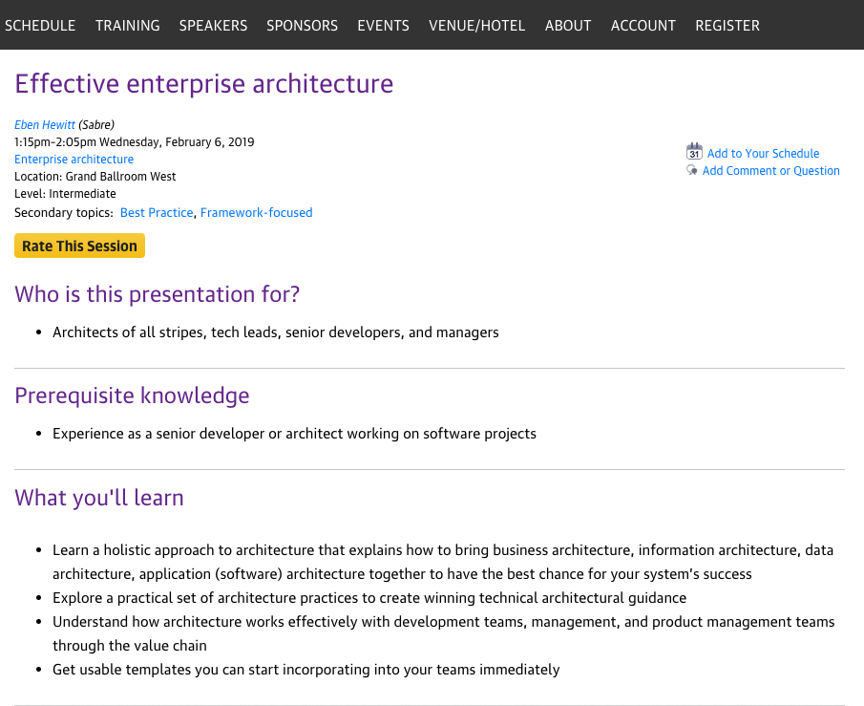
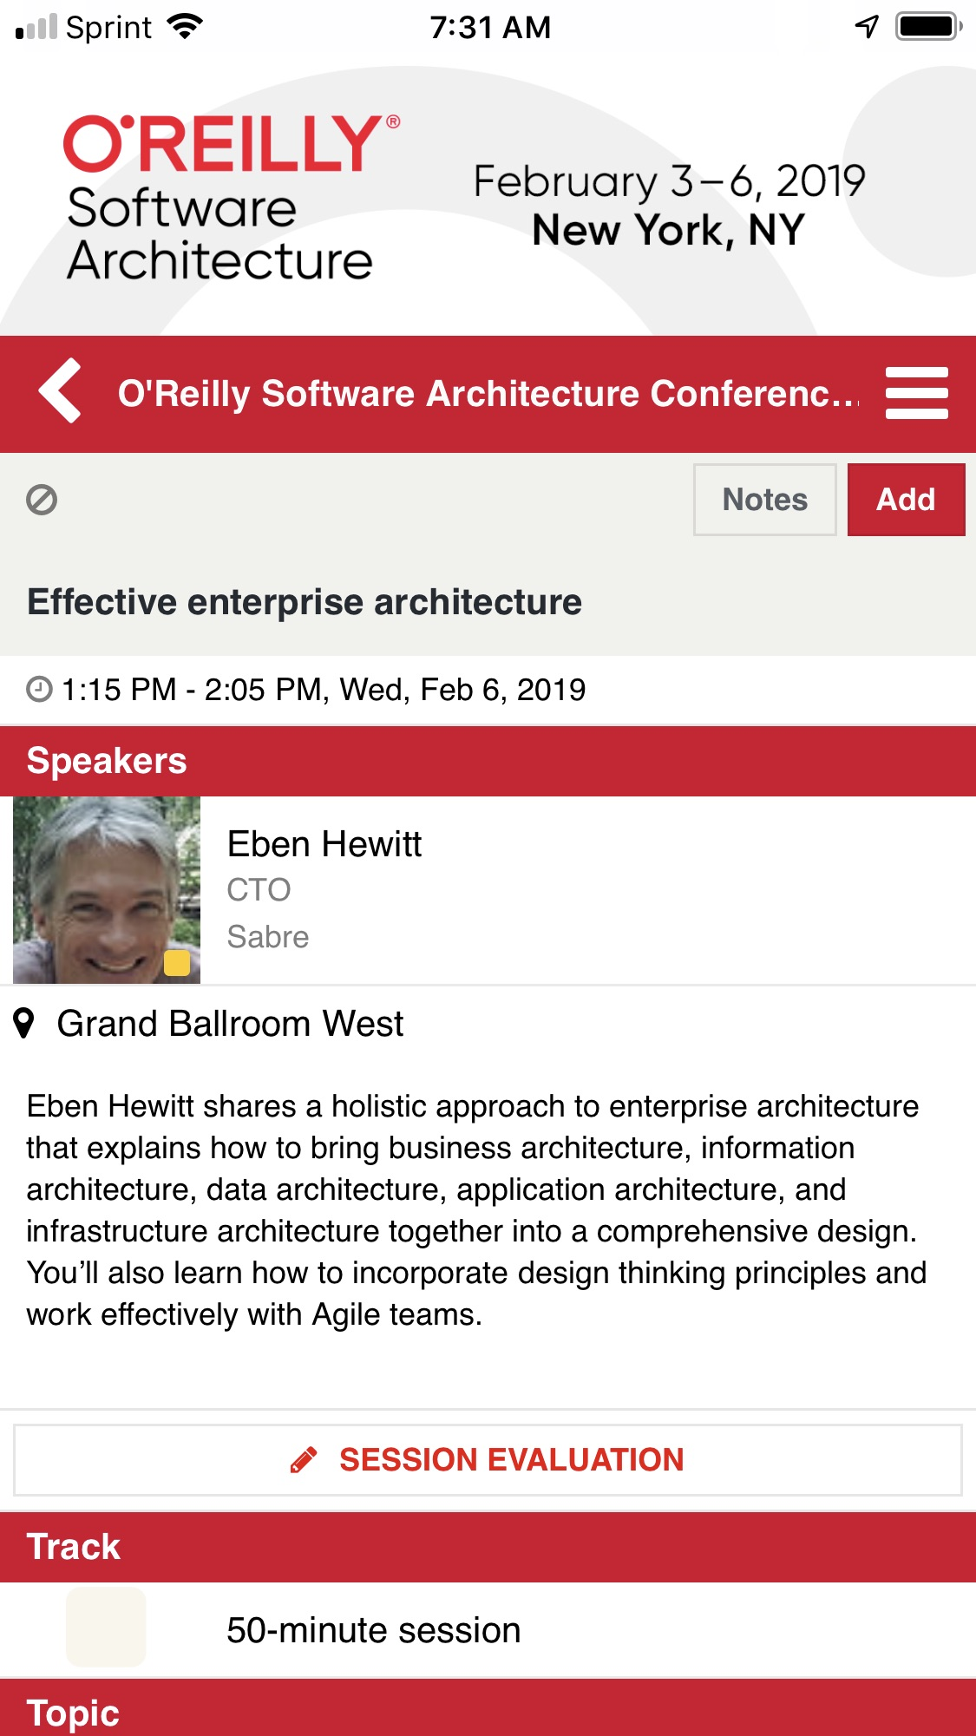
Rate today ’s session
Session page on oreillysacon.com/ny
O’Reilly Events App
Notes:
Please remember to rate the sessions you attend.

